Slide 1
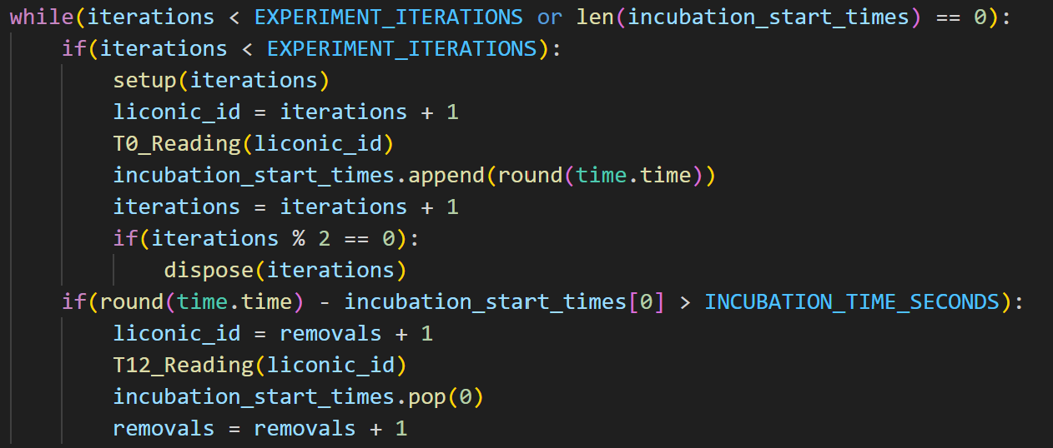
6/14/2023 Updates:
Implemented Tip Refill Script in C# - now successfully part of BIO workflow
Developing Multi-Run Code + Workflow that Can Hold Up to 12 Plates
Learned about Globus Data Transfer
Multi-Run Code
For each Loop:
IF WELL PLATES REMAIN:
1. Setup the Hudson Experiment
Always provides a 96 well and places top in Stack 1
If iterations is even, tip box and dilution deep well as well
If iterations is factor of 6, growth media deep well as well
2. Conduct Experiment to Incubation
3. “Dispose” of Used Materials
If total removals is even, gets rid of tip box and serial dilution plate
If total removals is factor of 6, dispose growth media deep well as well
Future Goals:
Testing Multiple Plates Up to 12 Plates
Implementing Data Reading from Globus
Learn about Machine Learning and AI to close the loop
Create a basic ML code for the BIO workcell
IF PLATES IN INCUBATOR + T12:
4. Conduct T12 Reading from designated plate ID + remove incubation start time once done
Alp Demirtas

